Slide 1
Mobile Device and Cloud Server based Intelligent Health Monitoring Systems
NAME: ZHAO Ding
SID: 52208367
Supervisor: Prof YAN, Hong
Assessor: Dr CHAN, Rosa H M
Sub-track in audio - visual processing

Slide 2
Objectives
Develop an Android App:
To display the user’s talking speech pitch in the run time. To generate the pitch contour and pitch range analysis.
To measure the user’s heart rate using the built-in camera.
To recognize the user’s emotion status based on captured facial image and recorded daily for long-term monitoring.

Slide 3




Motivations
Fast life pace. Work stress. Inconvenient to visit hospital.
Chronic diseases and mental health problems.
Essential to keep a record of daily emotion status.

Slide 4


Motivations
Smartphones:
indispensible part of modern life.
Possible for health condition monitoring.

Slide 5
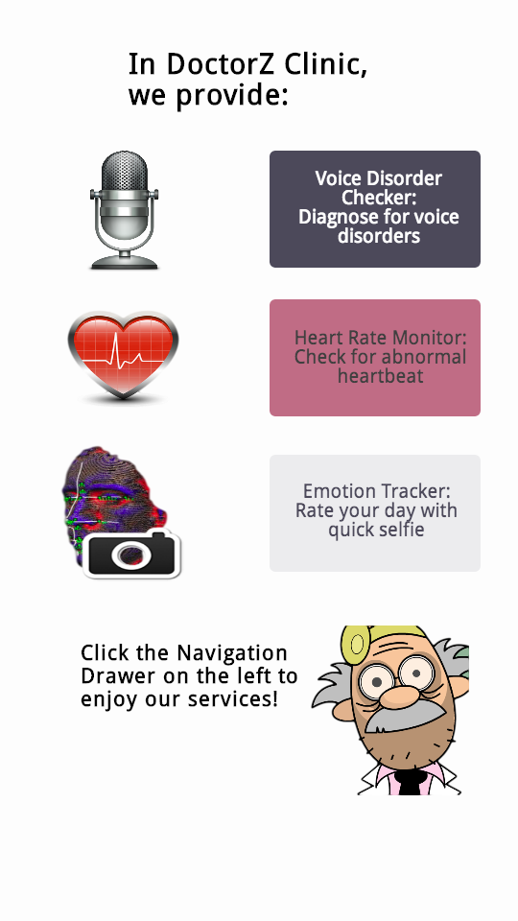
Work Done
Voice Disorder Checker
Heart Rate Monitor
Emotion Tracker

Slide 6

Work Done
Voice Disorder Checker
Heart Rate Monitor
Emotion Tracker

Slide 7
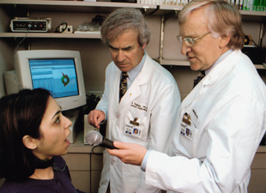
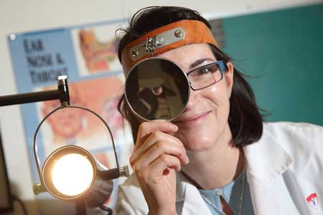
Voice Disorder Checker
Background
Clinicians & subjective rating.
Time-consuming.
Special instrument or complex software. [1]

Slide 8
Voice Disorder Checker
Record, sample and digitalize
Pitch calculation and display
sampling rate = 44100 Hz, encoding format = PCM 16 bit
Timeframe: 46ms
Pitch detection algorithms
Alert for abnormal feature
Feature extraction

Slide 9
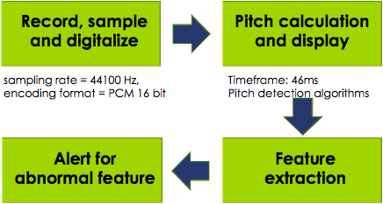

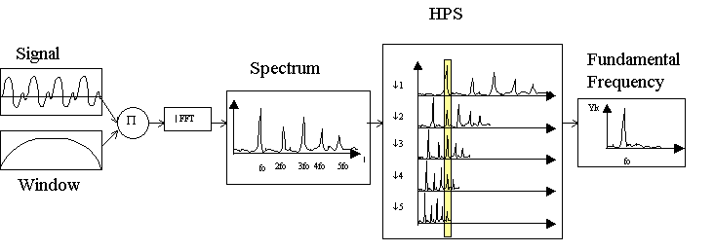
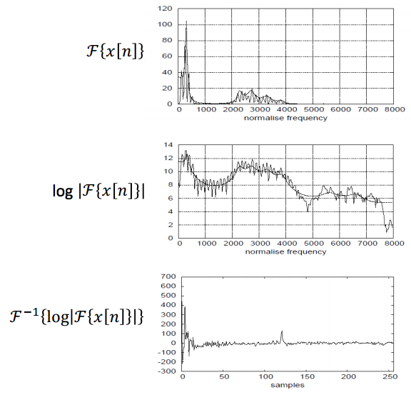
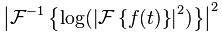
Voice Disorder Checker
Pitch Detection Algorithms
Direct Fast Fourier Transform
Harmonic Product Spectrum [2]
Cepstrum Analysis [3]

Slide 10
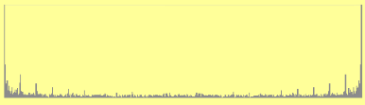
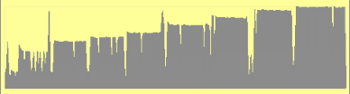
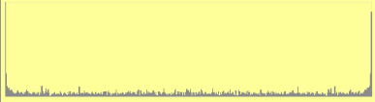
Voice Disorder Checker
Cepstrum Analysis
Cepstrum of particular speech segment
High-Key voice
Pitch contour over time
(do re mi fa so la si do)
Low-Key voice

Slide 11
Voice Disorder Checker
Checking Results:[5]
Abnormal Features | Related Voice Disorders
Unmatched pitch contour shape | Dysprosody
Reduced pitch range | Vocal fold nodule, Vocal Hemorrhage
Excessively high or low pitch | Bogart–Bacall syndrome, Muscle Tension Dysphonia

Slide 12

Work Done
Voice Disorder Checker
Heart Rate Monitor
Emotion Tracker

Slide 13
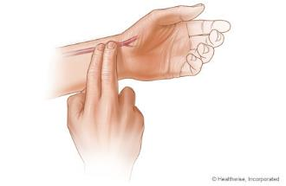

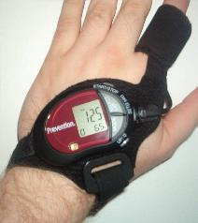
Heart Rate Monitor
Background

Slide 14
Heart Rate Monitor
Average red pixel intensity calculation
Video record
Use PreviewCallback to grab the latest image
Heart Rate deduction
Heartbeat ++
Red pixel value > Avg value
Collect data in 10 sec chunk

Slide 15
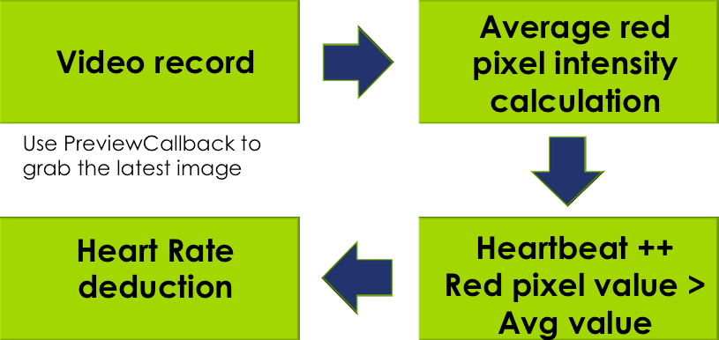
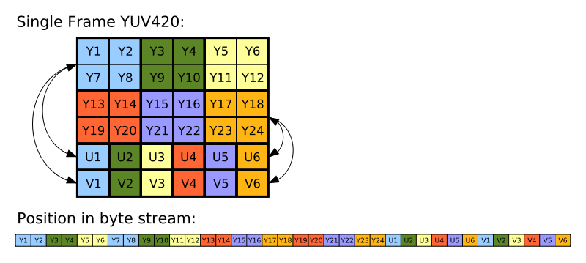
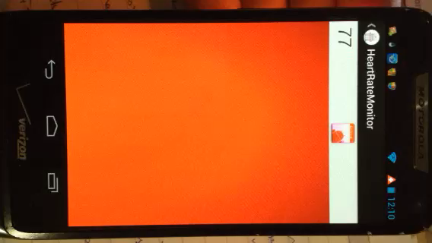
Heart Rate Monitor
Image color intensity calculation
YUV420SP != ARGB
Y = luminance
U and V = chrominance

Slide 16
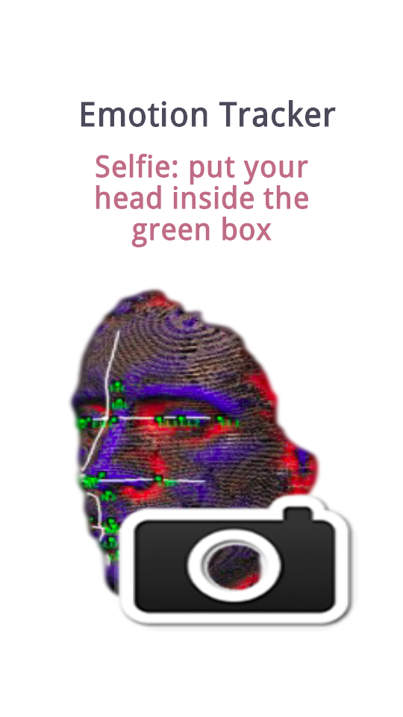
Work Done
Voice Disorder Checker
Heart Rate Monitor
Emotion Tracker

Slide 17
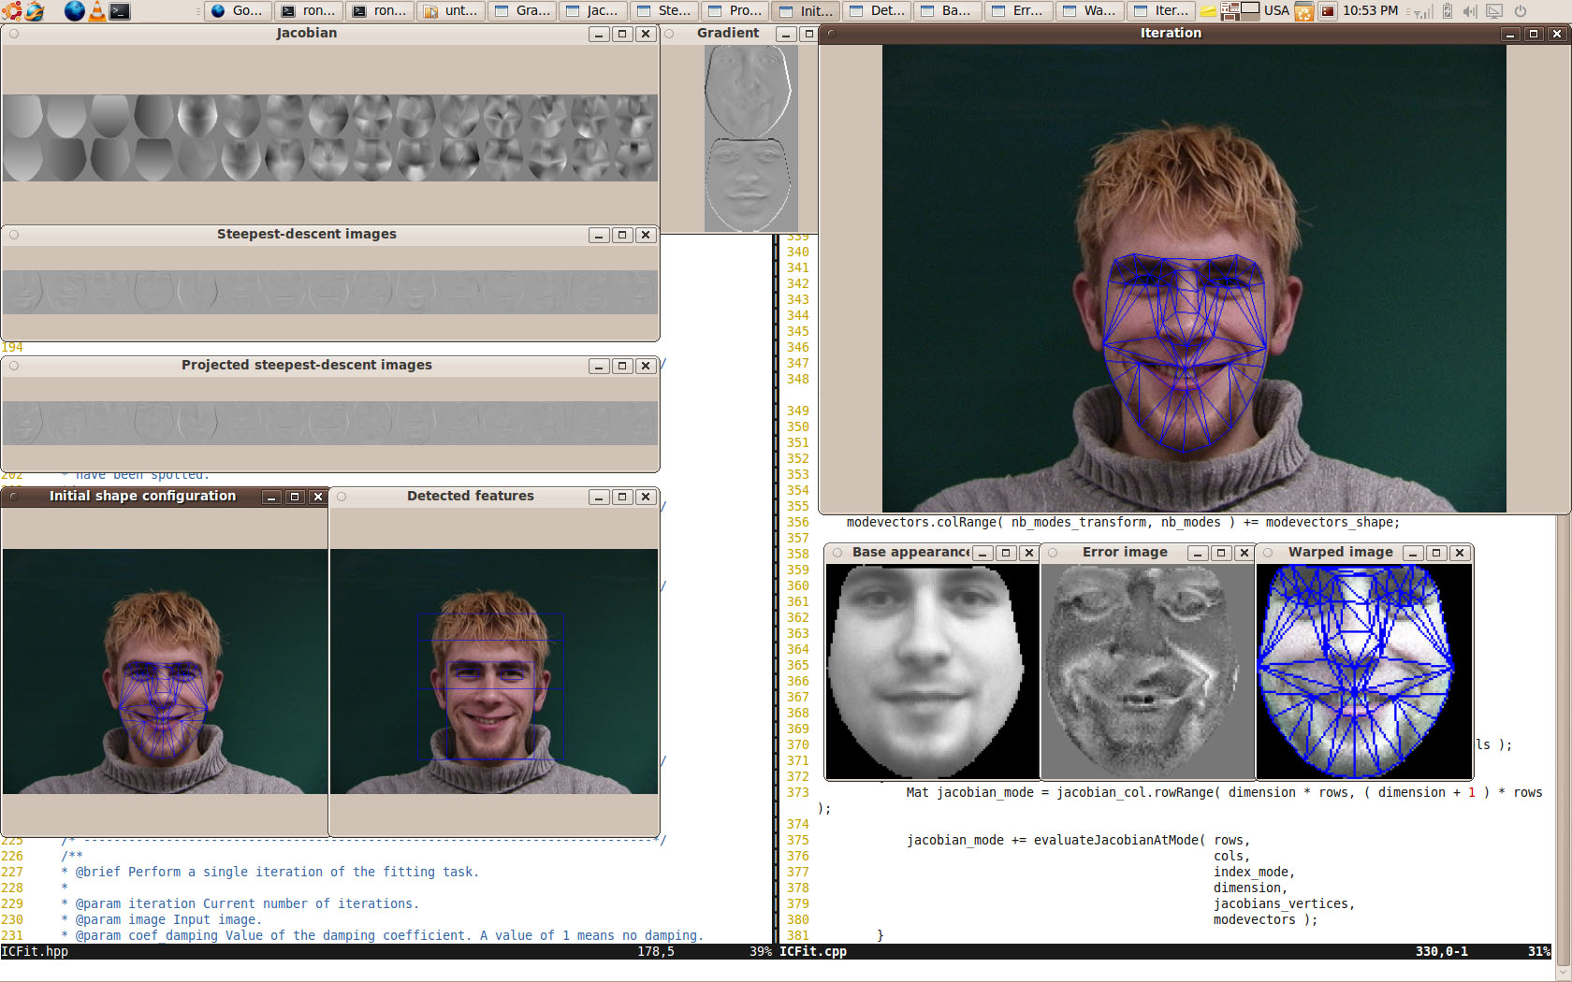

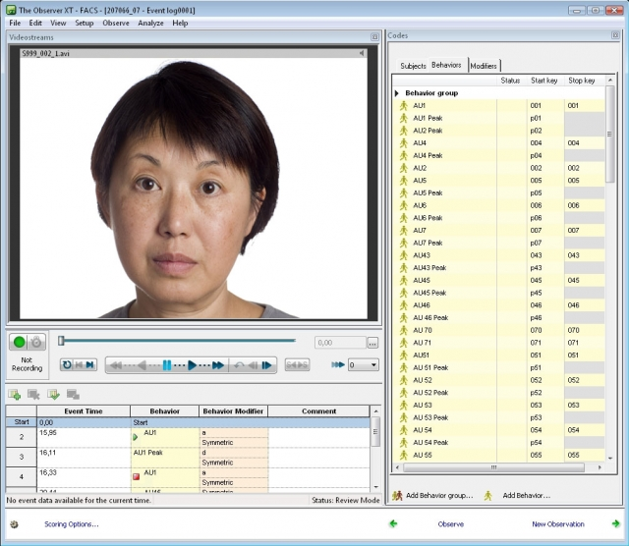
Emotion Tracker
Background
Static Approach
FisherFace Model
EigenFace Model [6]
Active Appearance Model [7]
Dynamic Approach
FACS intensity tracking [8]

Slide 18
Emotion Tracker
Background
Static Approach
FisherFace Model
EigenFace Model [6]
Active Appearance Model [7]
Dynamic Approach
FACS intensity tracking [8]

Slide 19
Emotion Tracker
Facial image capture
Feed to EigenFace model trained
Model trained from JAFFE database
Long term monitoring report
Classification result recorded

Slide 20
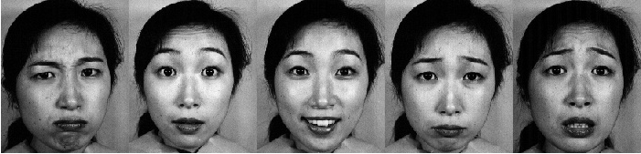
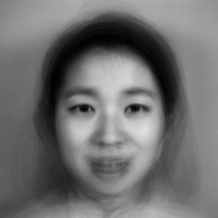
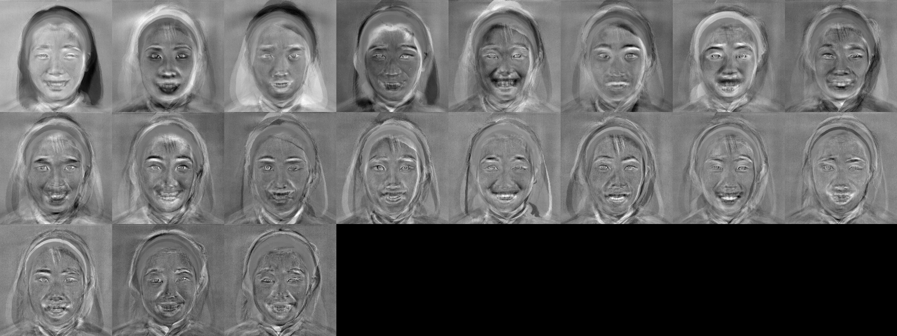
Emotion Tracker
Training images from JAFFE database:
EigenFace model
Principal Component Analysis
Average Eigen Image
Store training data in xml file
Training images eigenfaces

Slide 21

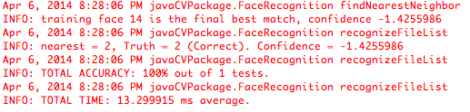

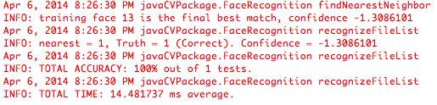
Emotion Tracker
EigenFace model
Load training data and test image
Run the find nearest neighbor algorithm

Slide 22
Conclusions
VoiceDisorderChecker:
Real-time speech pitch tracking.
HeartRateMonitor:
Heartbeat counting. Red pixel intensity variation of index fingertip image, representative of blood pulse rhythm.
EmotionTracker:
Static facial image expression recognition.

Slide 23
Work to be Done
Refine the pitch detection algorithm.
Evaluate the performance of EmotionTracker using figherface model.
More emotion categories when training eigenface model
Better design for App user interface
Release as beta version
Deploy the App to Google Cloud Platform

Slide 24
References
[1] Koichi OMORI, “Diagnosis of Voice Disorders,” JMAJ, Vol. 54, No. 4, pp. 248–253, 2011.
[2] TCH DETECTION METHODS REVIEW [Online]. Available: http://ccrma.stanford.edu/~pdelac/154/m154paper.htm
[3] A. Michael Noll, “Cepstrum Pitch Determination,” Journal of the Acoustical Society of America, Vol. 41, No. 2, (February 1967), pp. 293-309.
[4] Alan V. Oppenheim and Ronald W. Schafer, Discrete-Time Signal Processing, Prentice Hall, 2009.
[5] Deirdre D. Michael. (2012, Dec 1). Types of Voice Disorders. [Online]. Available: http://www.lionsvoiceclinic.umn.edu/page3b.htm

Slide 25
References
[6] Gender Classification with OpenCV. [Online]. Available at http://docs.opencv.org/trunk/modules/contrib/doc/facerec/tutorial/facerec_gender_classification.html#fisherfaces-for-gender-classification
[7] Timothy F. Cootes, Gareth J. Edwards, and Christopher J. Taylor. “Active Appearance Models.” IEEE TRANSACTIONS ON PATTERN ANALYSIS AND MACHINE INTELLIGENCE, VOL. 23, NO. 6, JUNE 2001.
[8] Maja Pantic, Student Member, IEEE, and Leon J.M. Rothkrantz. “Automatic Analysis of Facial Expressions: The State of the Art.” IEEE TRANSACTIONS ON PATTERN ANALYSIS AND MACHINE INTELLIGENCE, VOL. 22, NO. 12, DECEMBER 2000.

Slide 26
Q & A

